Slide 1
Brain Norm

Slide 2
Week 1

Slide 3
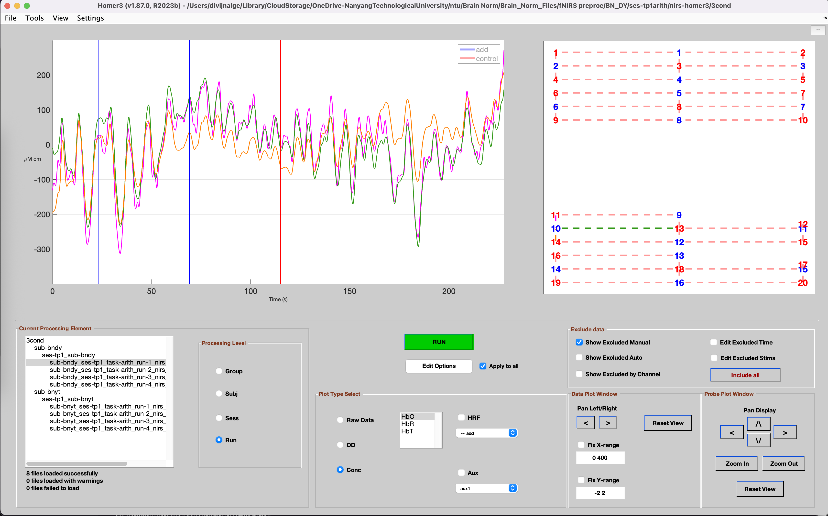

Slide 4
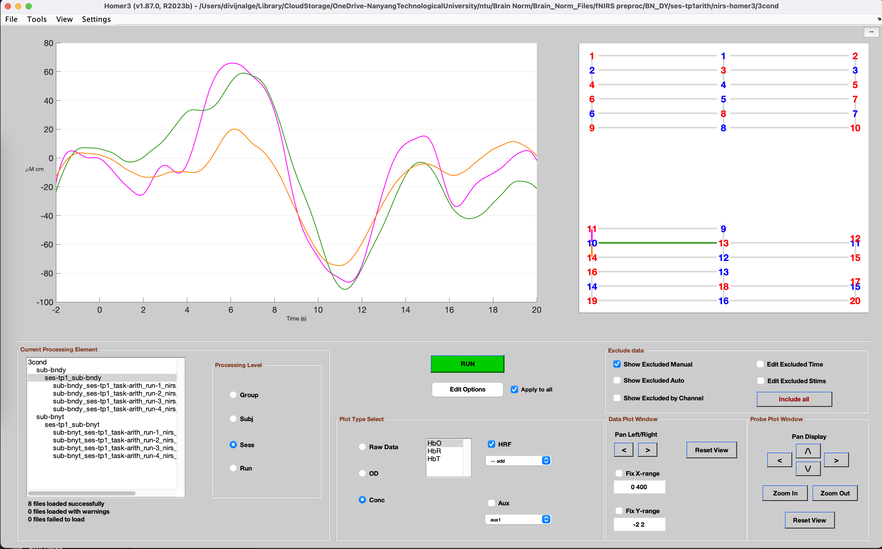

Slide 5
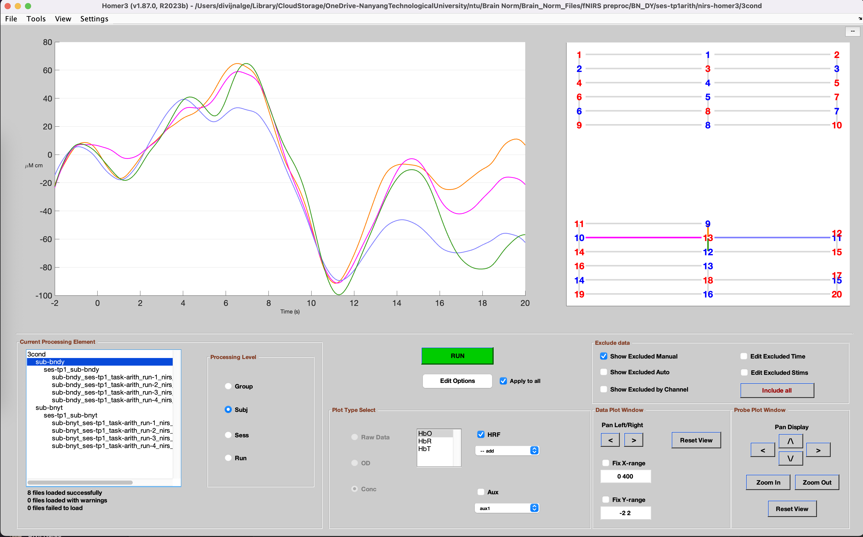

Slide 6
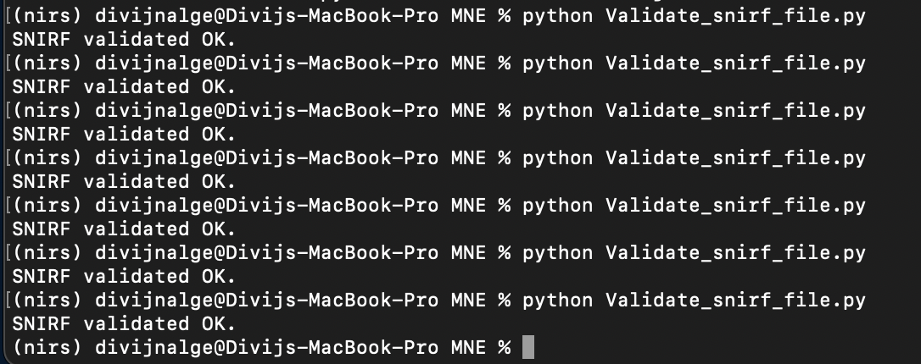

Slide 7
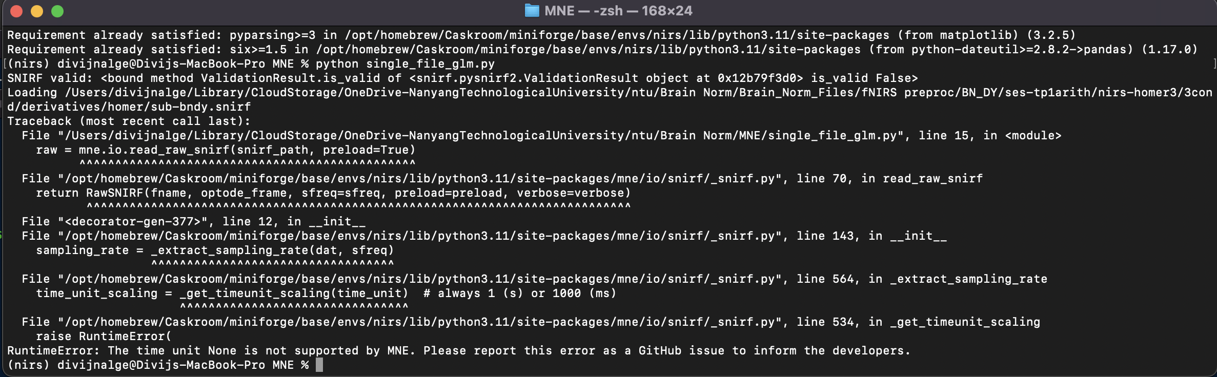

Slide 8
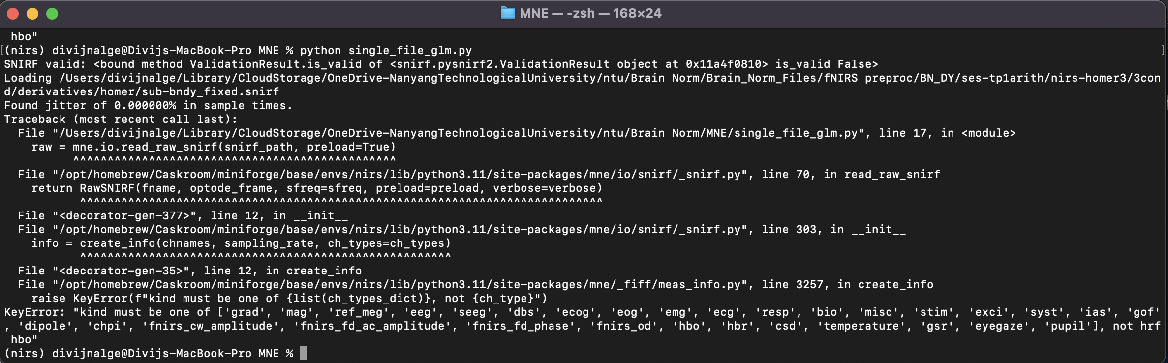

Slide 9
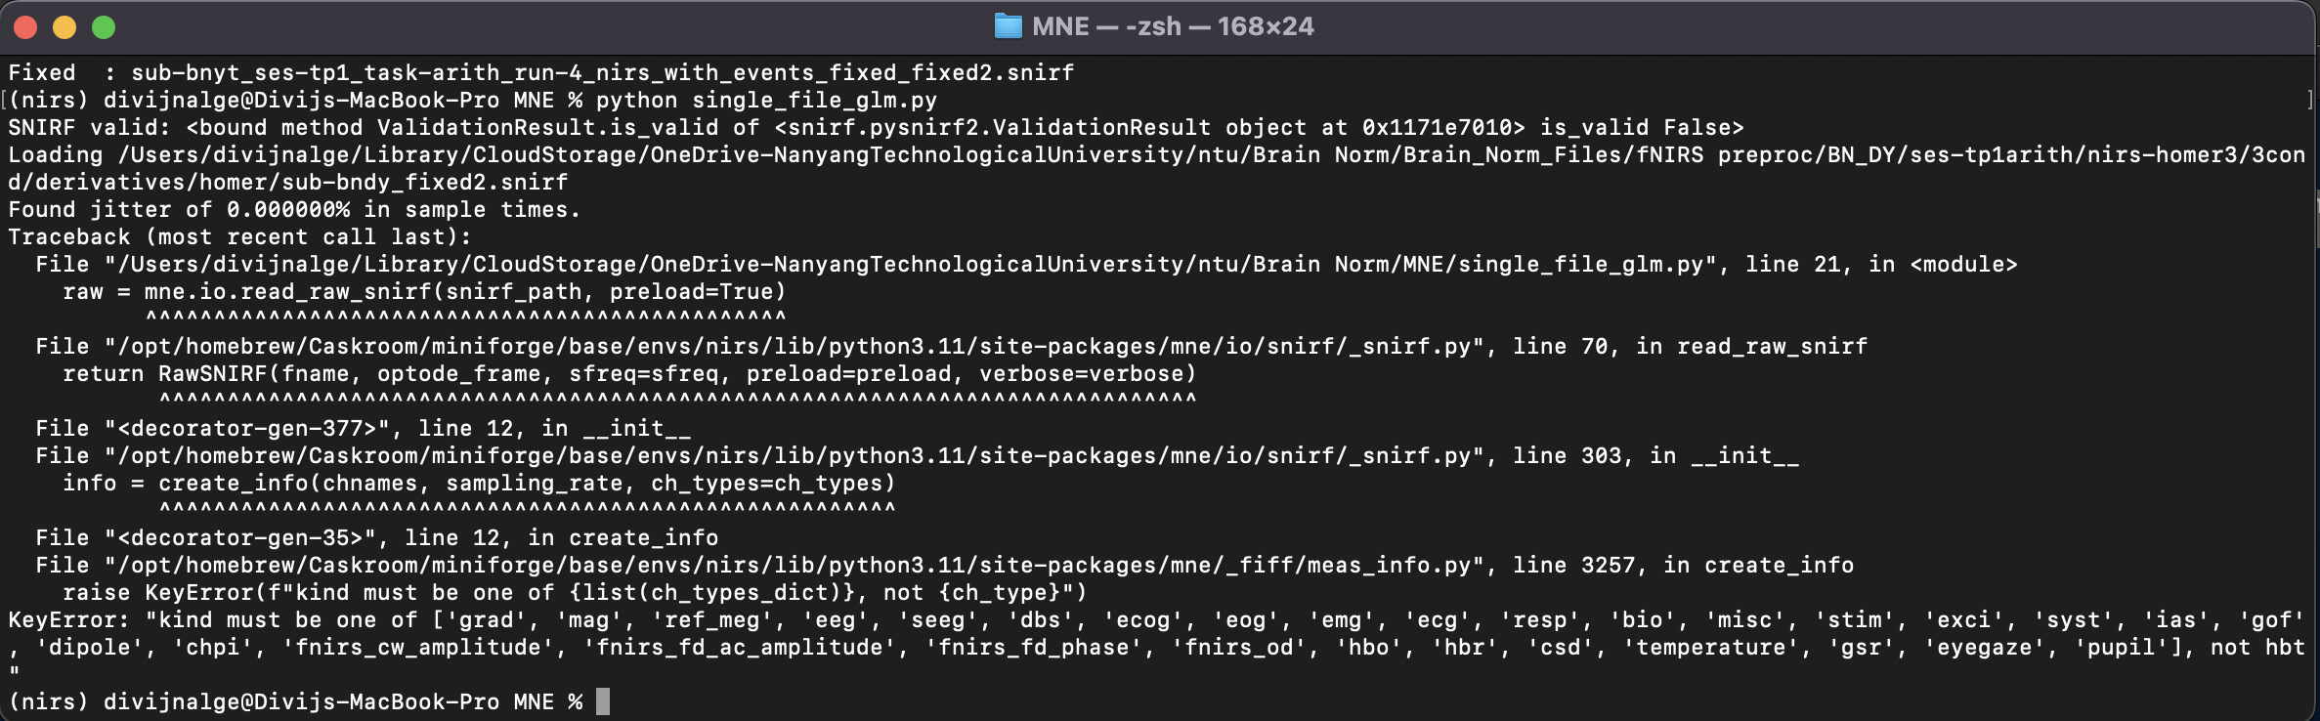

Slide 10
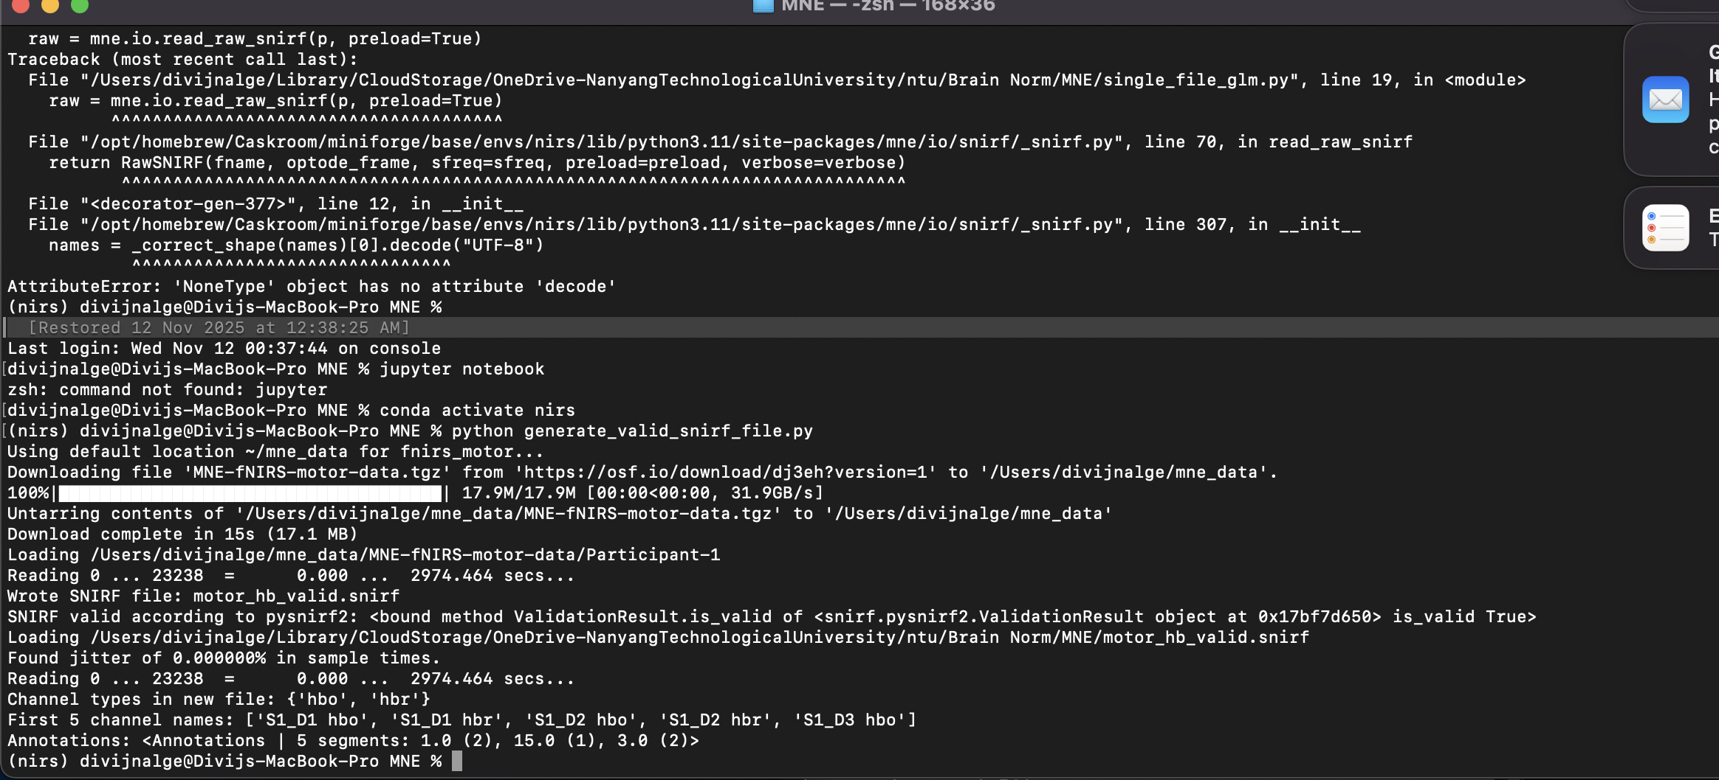

Slide 11
Week 2 & 3
Convert Homer3 preprocessed .snirf file to MNE compatible .snirf.
Run a GLM from Homer3
Check what is going wrong with the modified pruning files.
Try to validate .snirf files without processing it through Homer3

Slide 12
Convert Homer3 preprocessed .snirf file to MNE compatible .snirf
SNIRF files exported from Homer3 are partially compatible with MNE, but not fully compliant with the strict SNIRF standard that MNE expects.
You can load them in MNE after cleaning or patching the file but not directly — because of metadata and label mismatches.

Slide 13
Issue | Homer3 Export Behavior | What MNE Expects
TimeUnit | Often missing or None | Must be "s" (seconds)
Channel Type Labels | Can be "hrf hbo", "hbt", "hrf hbr" etc. | Must be exactly "hbo", "hbr", "fnirs_od", etc.
Probe Labels | May include None, empty strings, or duplicated names | Must be valid UTF-8 strings, all unique
Stimulus Events | Sometimes unnamed or duplicated | Must have a non-empty "name" field

Slide 14
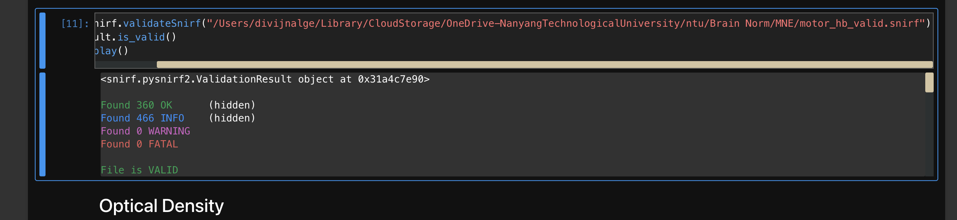
The demo dataset is downloaded directly from the official MNE-Python dataset server passes the validation.

Slide 15
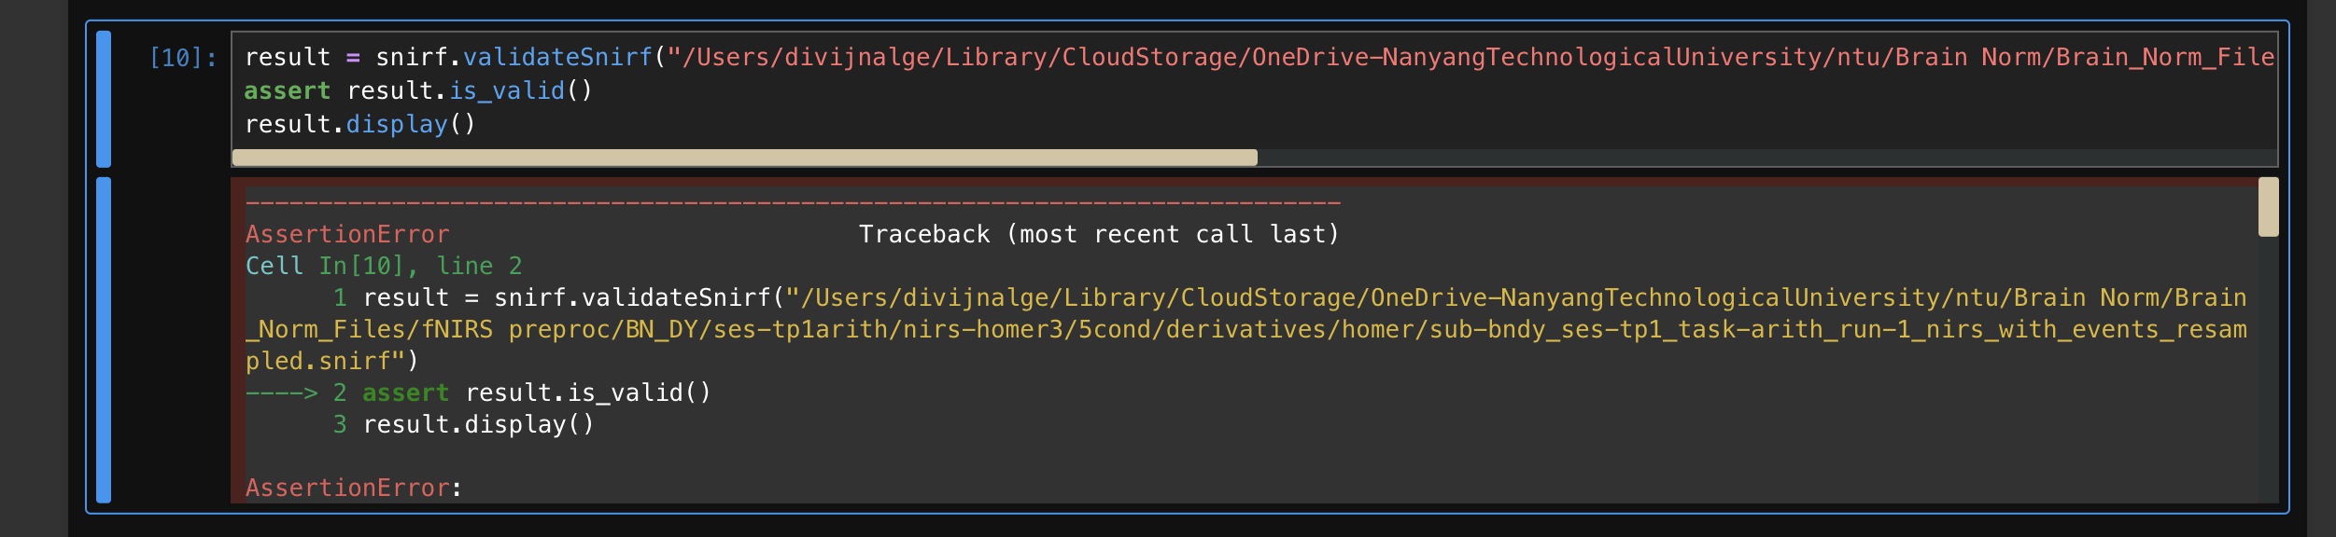
Your Homer3-exported .snirf file exists and loads, but it fails SNIRF validation according to pysnirf2.validateSnirf().

Slide 16
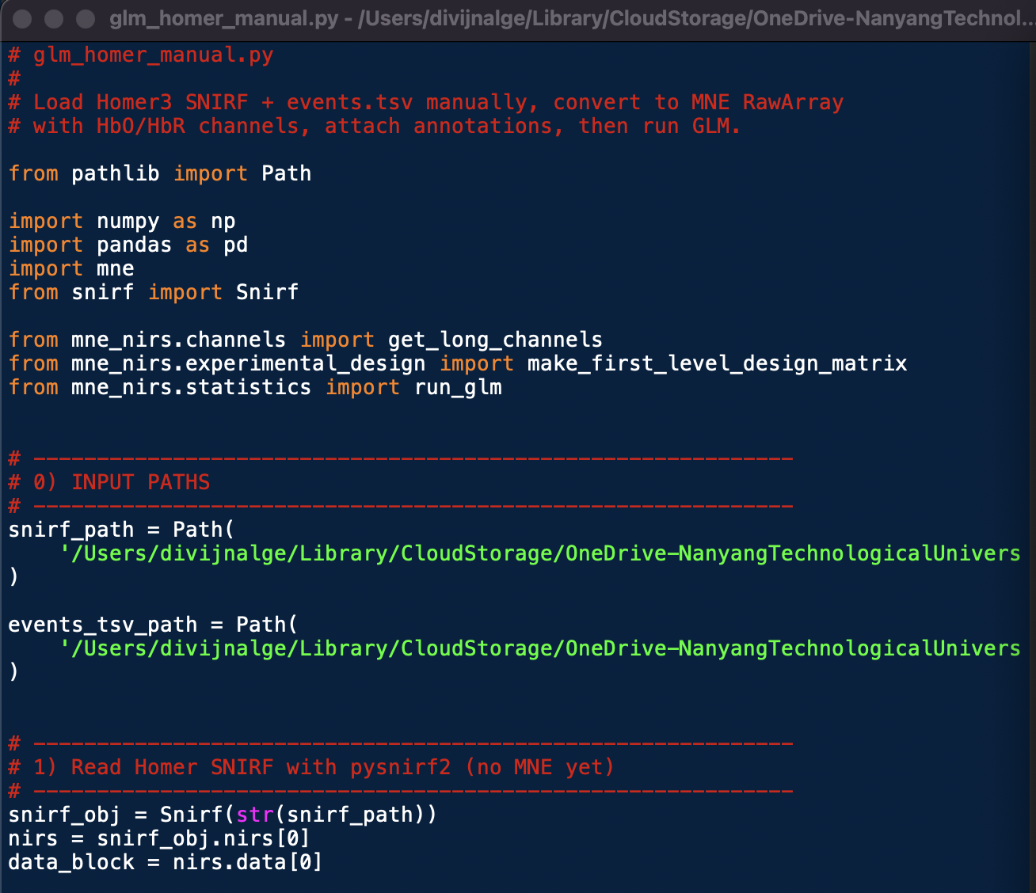
Generate a MNE compatible .snirf

Slide 17
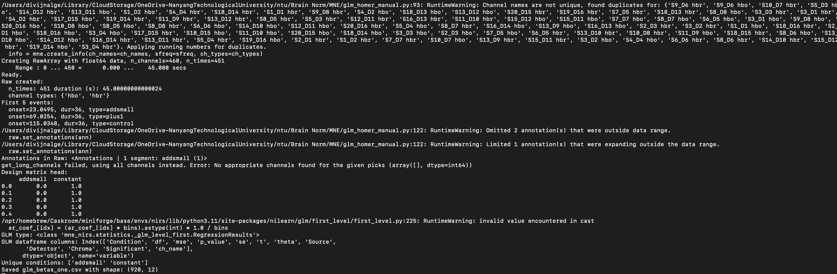

Slide 18
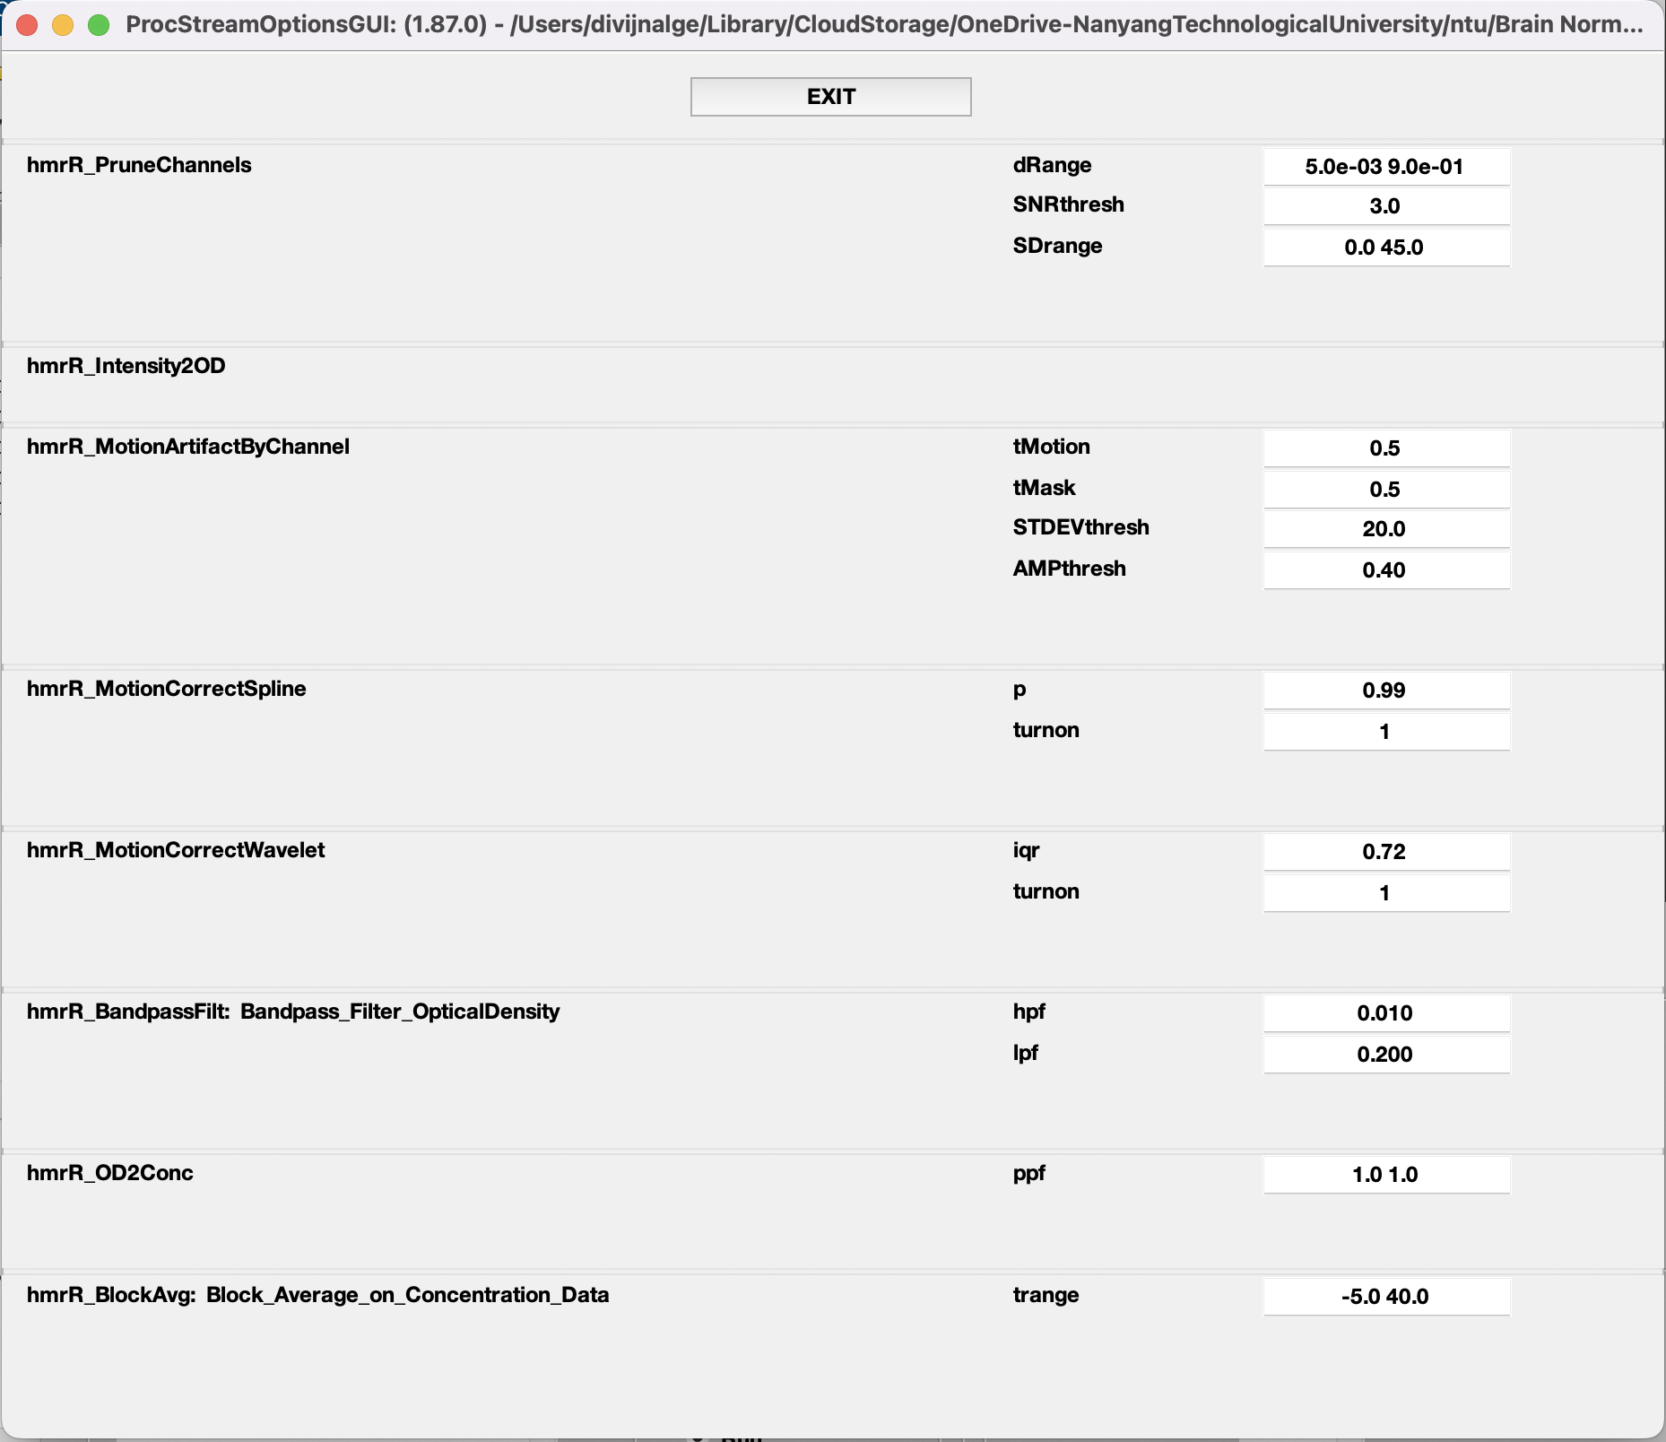

Slide 19
Week 4
Export the .snirf file without block_avg
Run Homer3 without gui to avoid export bug
Remove HbT channel (not recognized by MNE)
Fix metadata
Validate snirf file

Slide 20
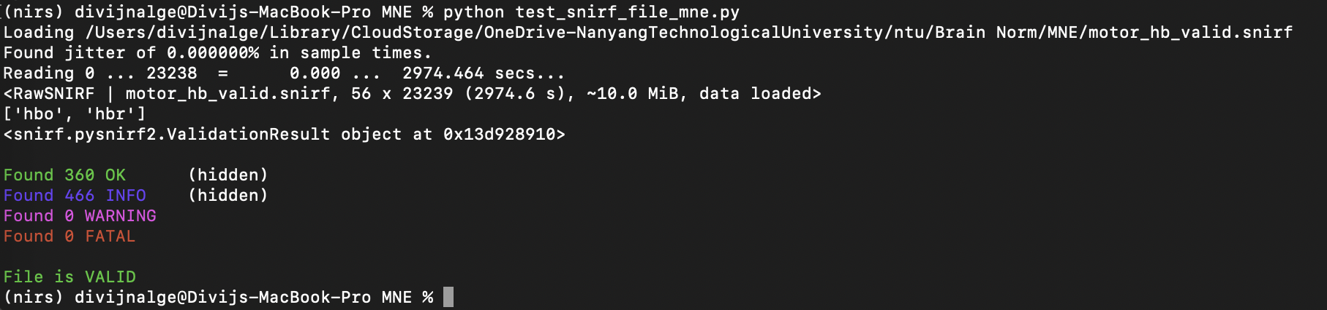
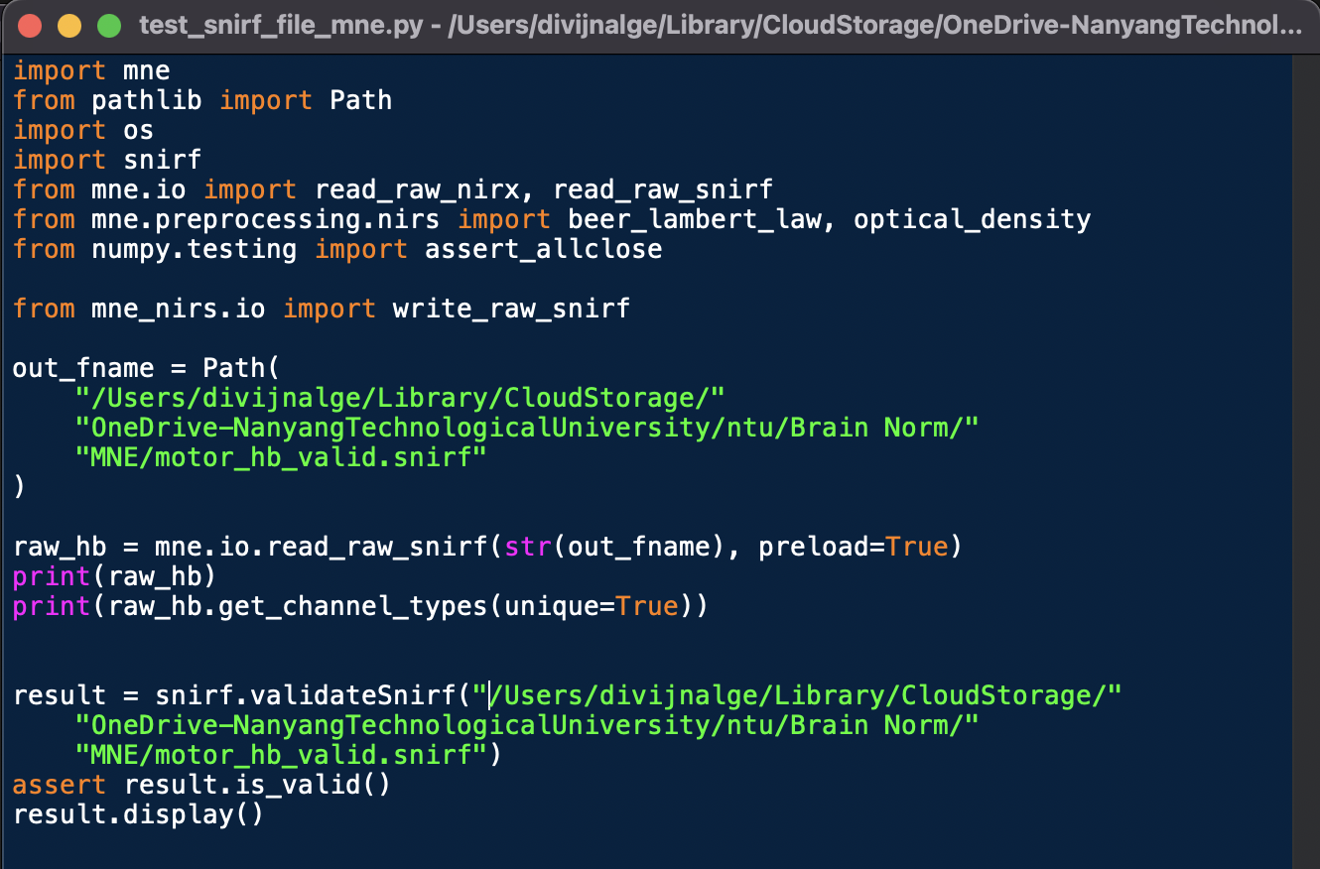
Validate file and check file loading in MNE

Slide 21
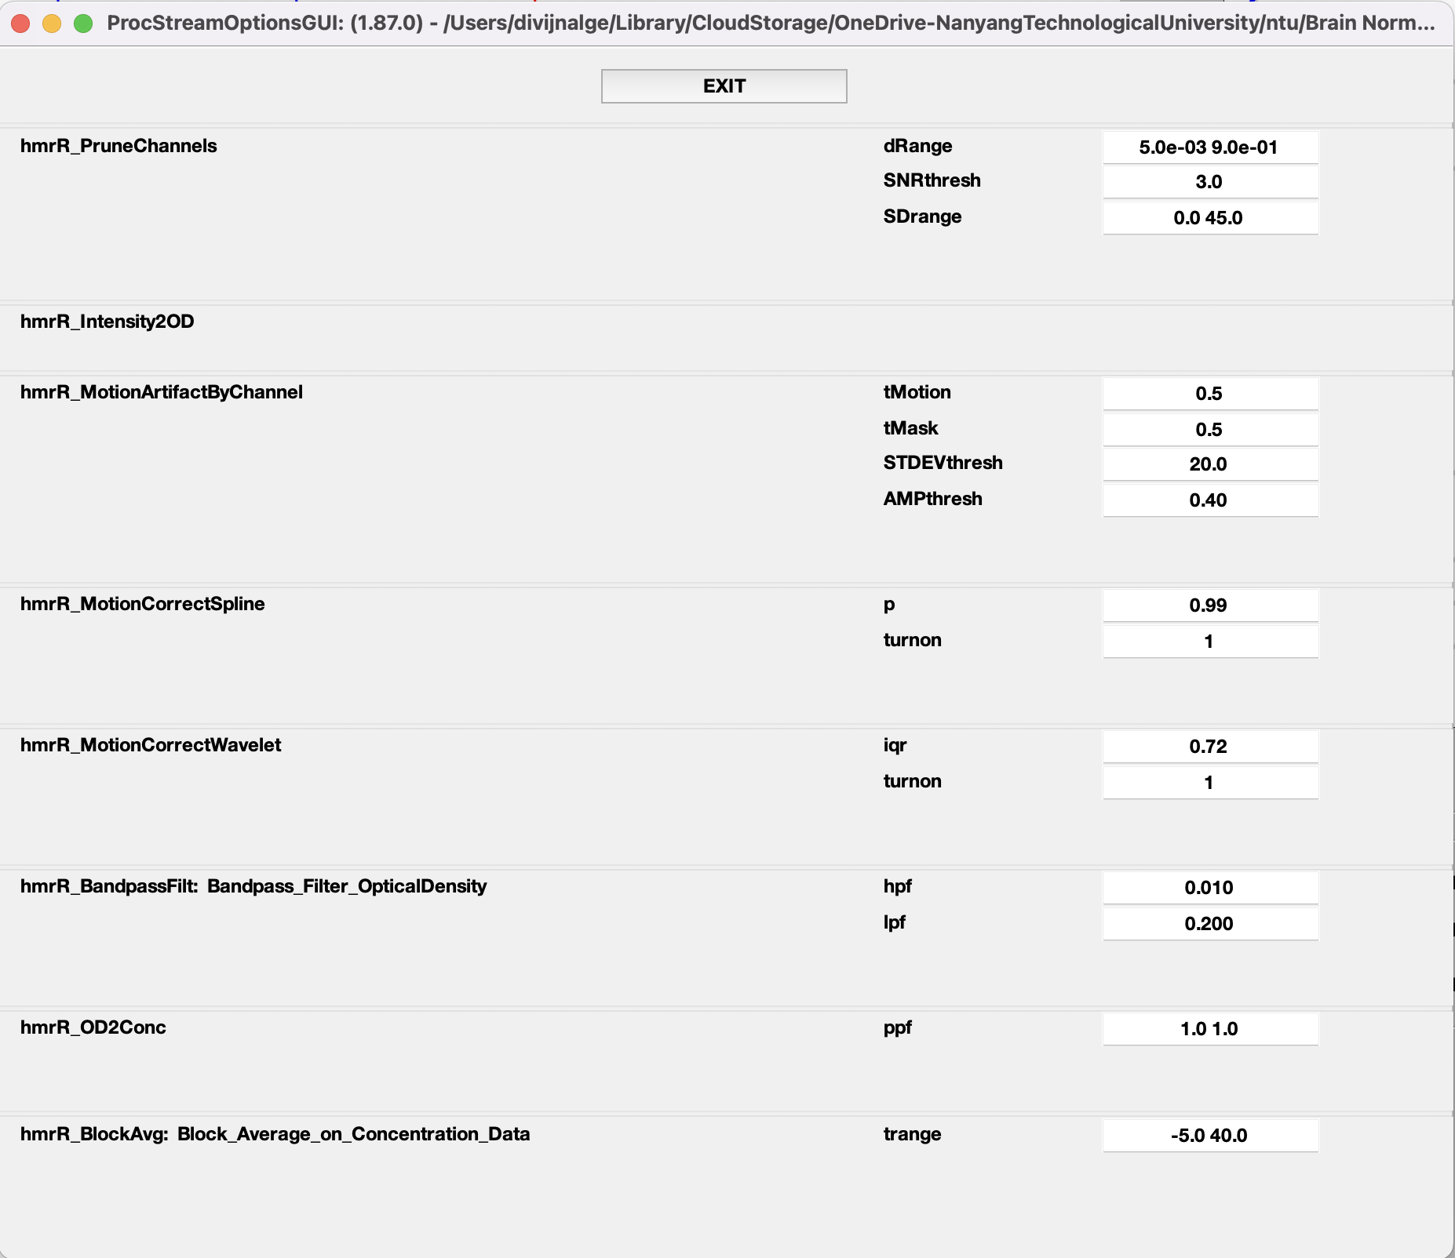
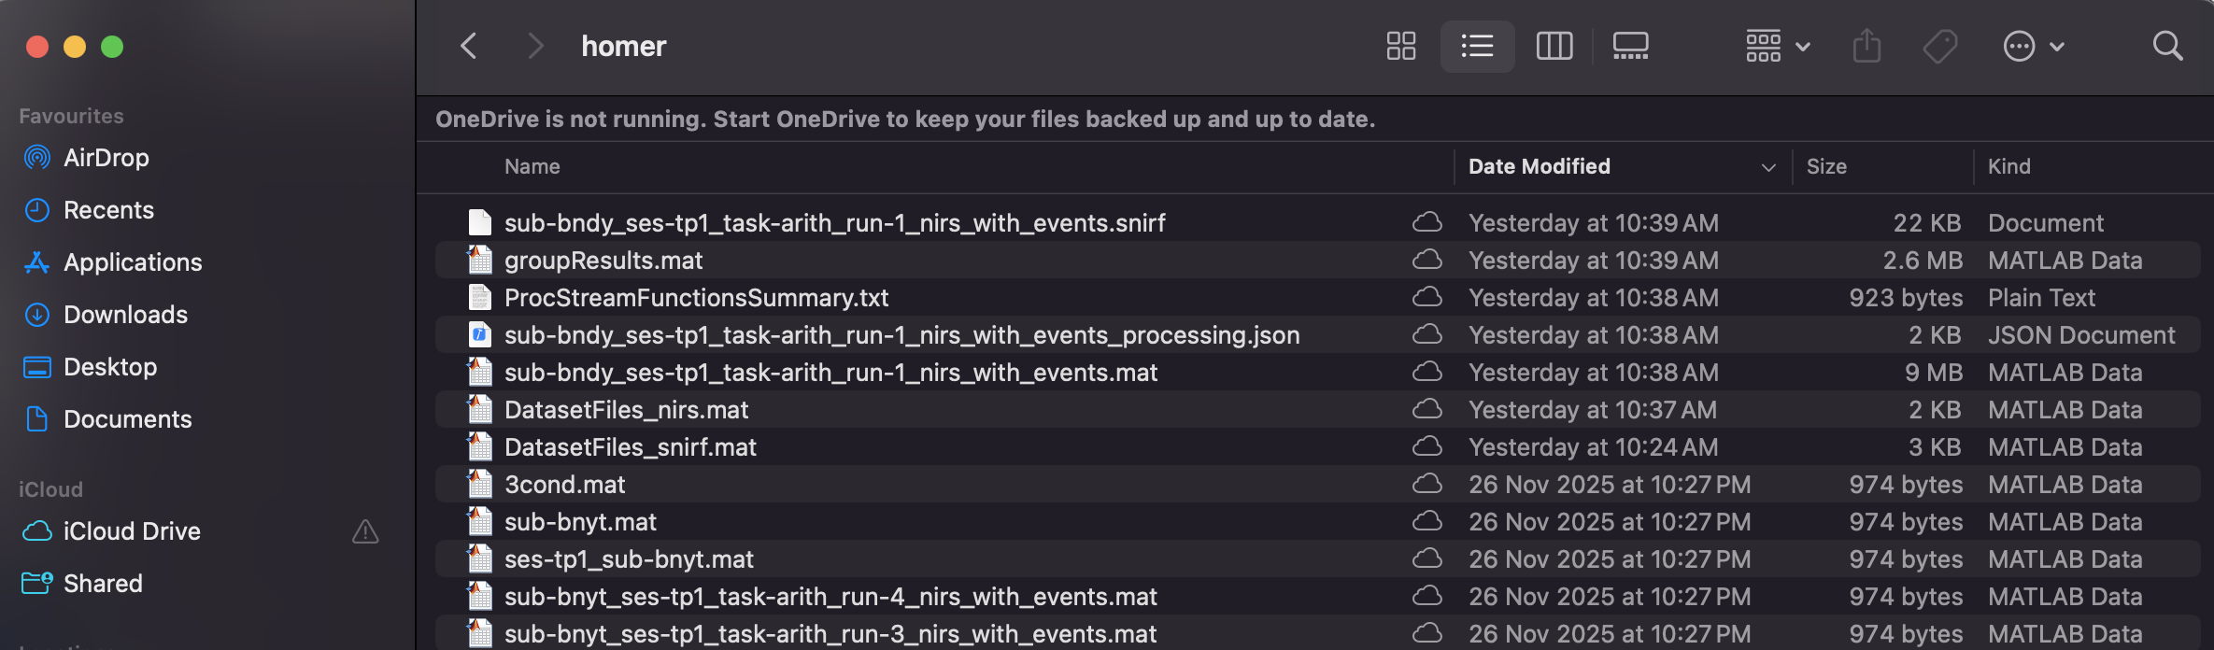
Export the .snirf file without block_avg

Slide 22
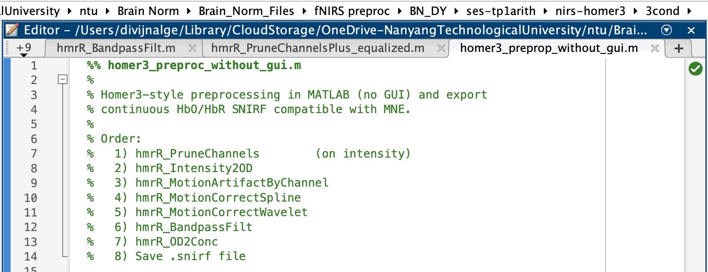
Run Homer3 without gui to avoid export bug

Slide 23
Loading SNIRF: sub-bndy_ses-tp1_task-arith_run-1_nirs_with_events.snirf
Running hmrR_PruneChannels...
hmrR_PruneChannels: excluded channels [ 1 2 3 4 7 10 11 12 16 17 26 27 28 33 37 45 1 2 3 4 7 12 16 17 26 27 28 33 ] based on dRange=[ 0.005 0.9 ] at wavelength 2
Running hmrR_Intensity2OD...
Running hmrR_MotionArtifactByChannel...
Running hmrR_MotionCorrectSpline...
Running hmrR_MotionCorrectWavelet...
Loading /Users/divijnalge/Library/CloudStorage/OneDrive-NanyangTechnologicalUniversity/ntu/Brain Norm/Homer3/Install/db2.mat
*****************************************
** DWT Extension Mode: Periodization **
*****************************************
Running hmrR_BandpassFilt (hpf = 0.010, lpf = 0.200)...
Running hmrR_OD2Conc...
Saving continuous HbO/HbR SNIRF:
output_preproc_hb.snirf
Done.

Slide 24
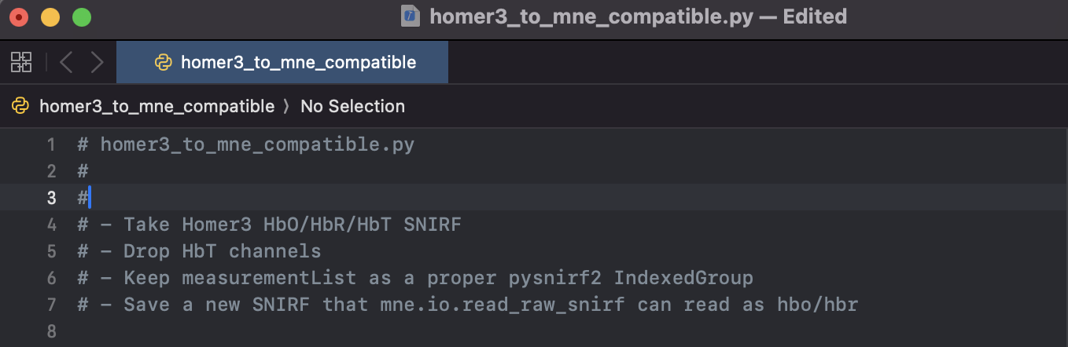
Remove HbT channel (not recognized by MNE)

Slide 25
(nirs) divijnalge@Divijs-MacBook-Pro MNE % python homer3_to_mne_compatible.py
Input SNIRF: /Users/divijnalge/Library/CloudStorage/OneDrive-NanyangTechnologicalUniversity/ntu/Brain Norm/Brain_Norm_Files/fNIRS preproc/BN_DY/ses-tp1arith/nirs-homer3/3cond/output_preproc_hb.snirf
Will write: /Users/divijnalge/Library/CloudStorage/OneDrive-NanyangTechnologicalUniversity/ntu/Brain Norm/Brain_Norm_Files/fNIRS preproc/BN_DY/ses-tp1arith/nirs-homer3/3cond/output_preproc_hb_mne.snirf
Unique dataTypeLabel values BEFORE: ['HbO', 'HbR', 'HbT']
Total channels: 138
Keeping 92 channels (HbO/HbR only)
Dropping 46 channels (e.g. HbT)
Done.

Slide 26
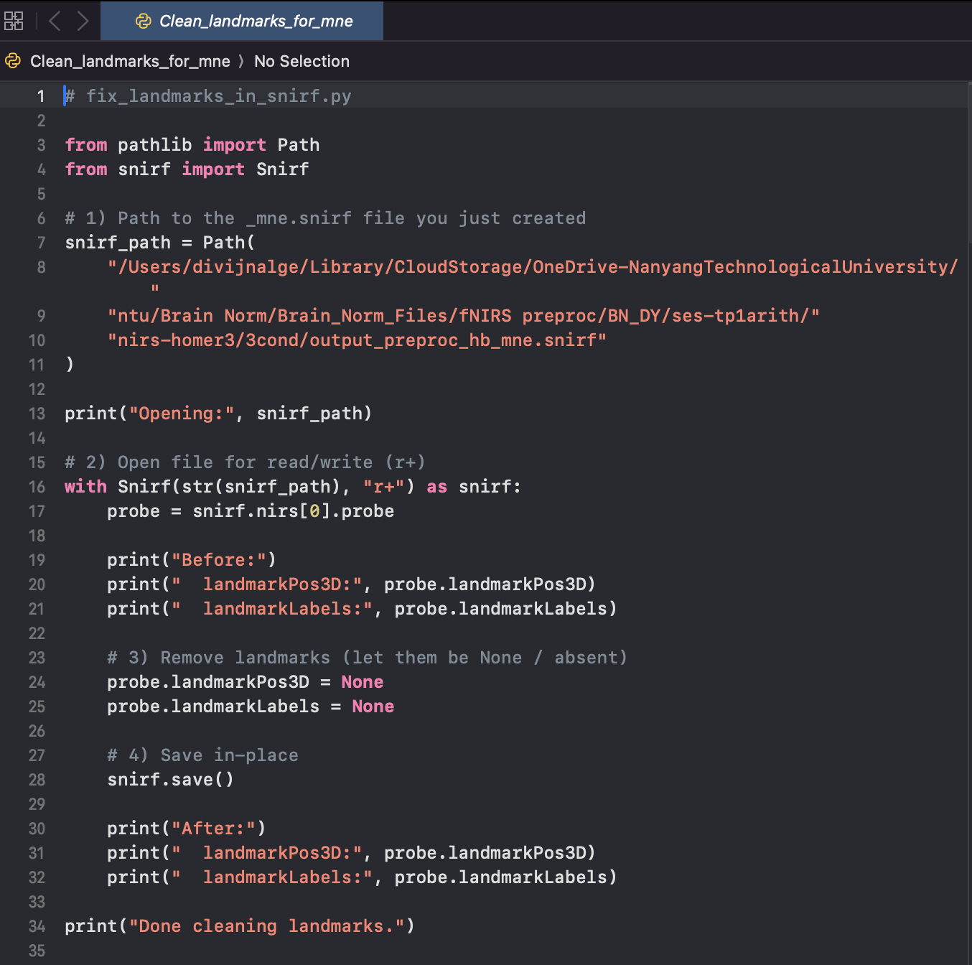
Fix metadata – Error 1
TypeError: iteration over a 0-d array
...
for idx, dign in enumerate(digname):

Slide 27
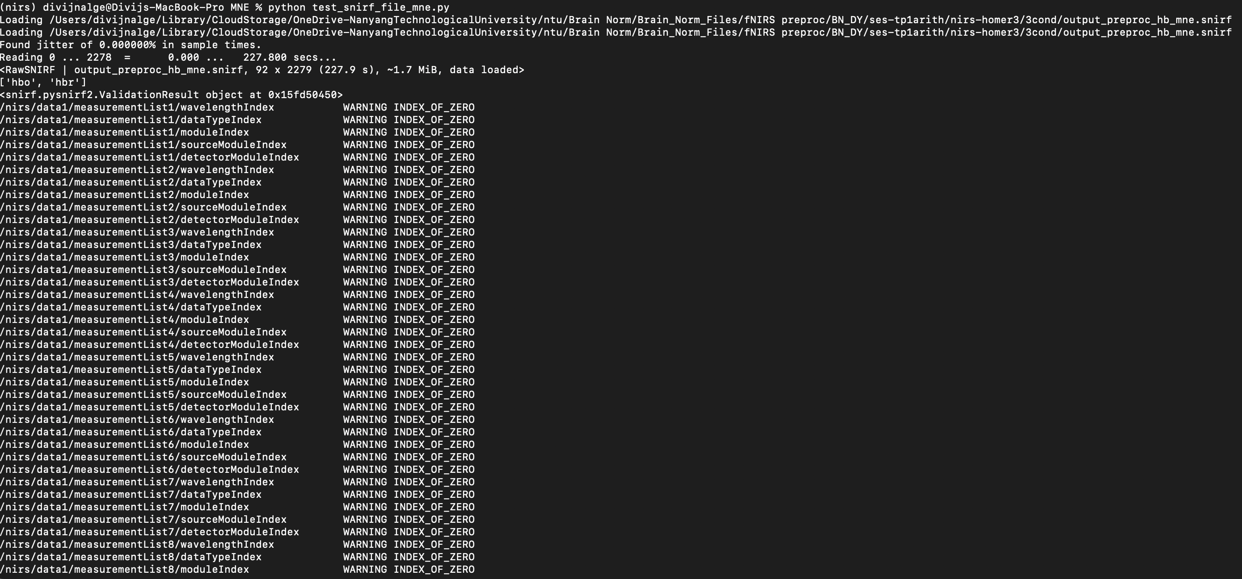
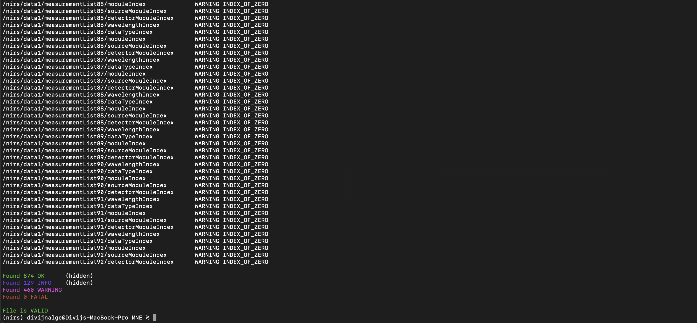
Fix metadata - warnings

Slide 28
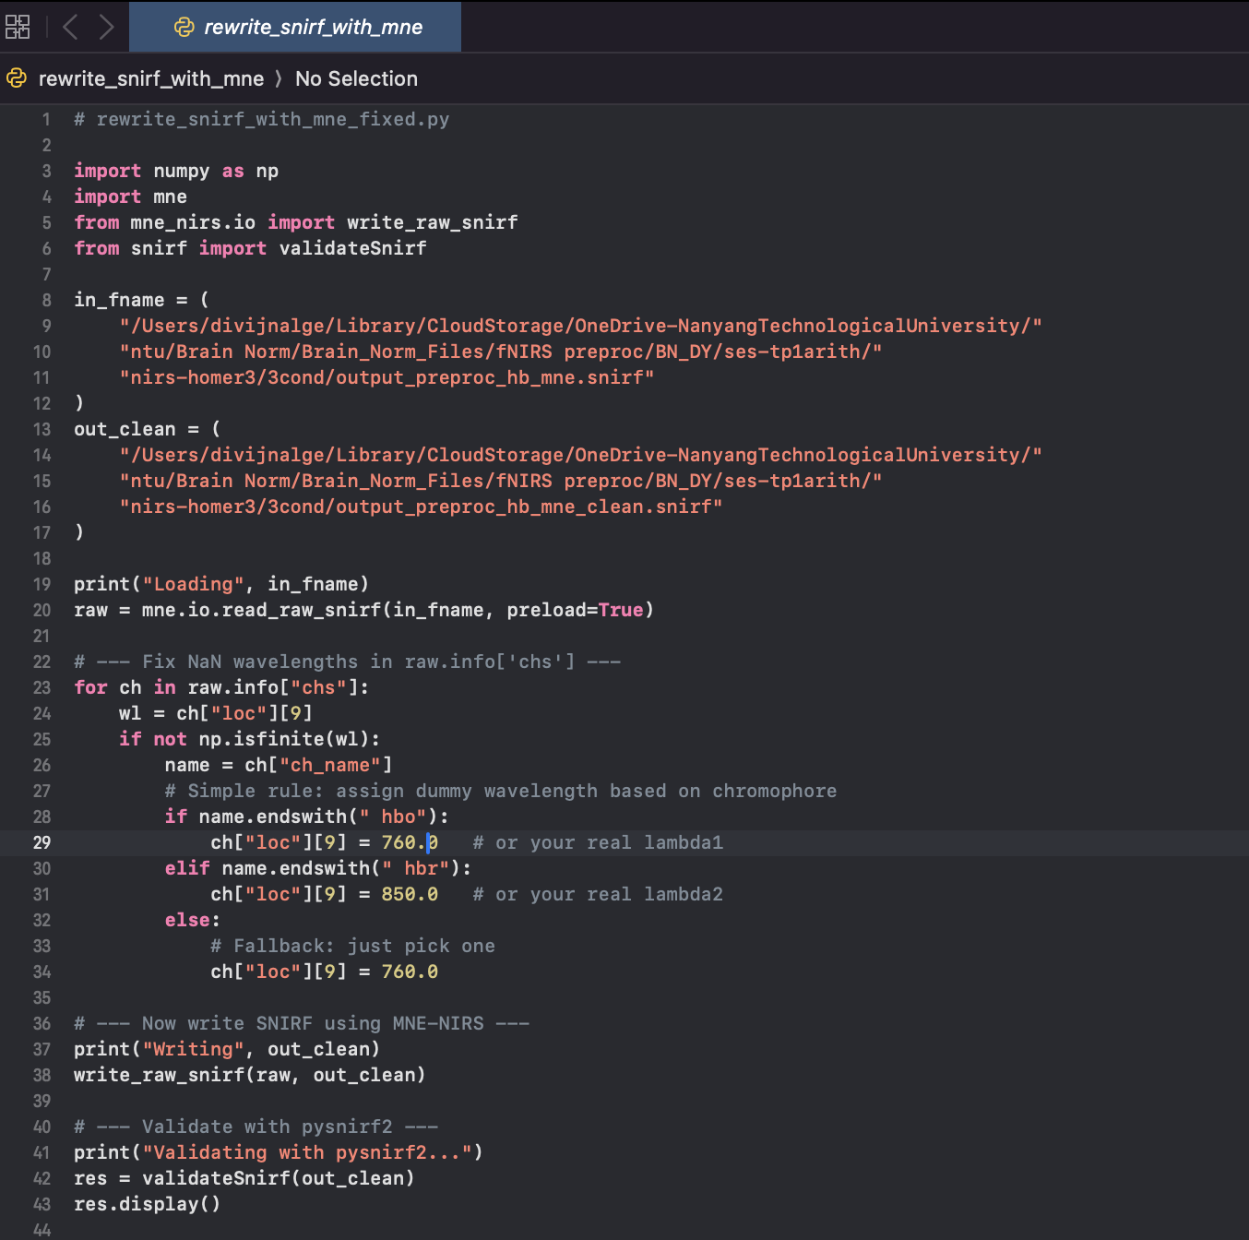

Slide 29
Fix metadata – Error 2
ValueError: np.float64(nan) is not in list
...
wavelength_idx = wavelengths.index(raw_wavelengths[idx - 1]) + 1

Slide 30
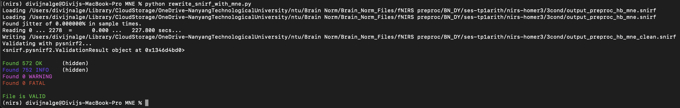

Slide 31
Run glm from MNE
Run glm from Homer3 without gui
Use the customized pruning scripts to do above

Slide 32
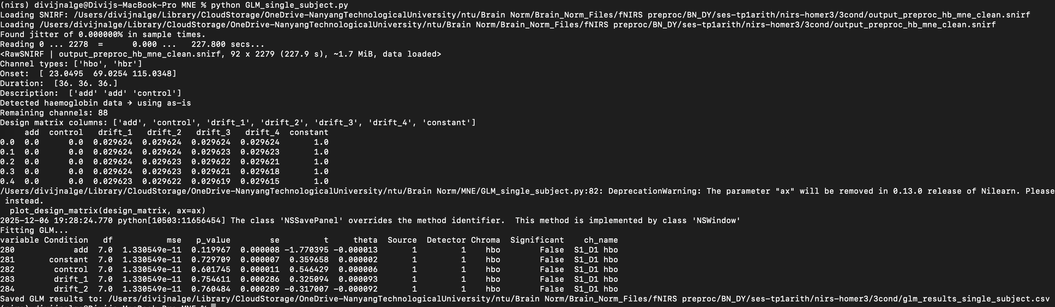
Running GLM in MNE

Slide 33
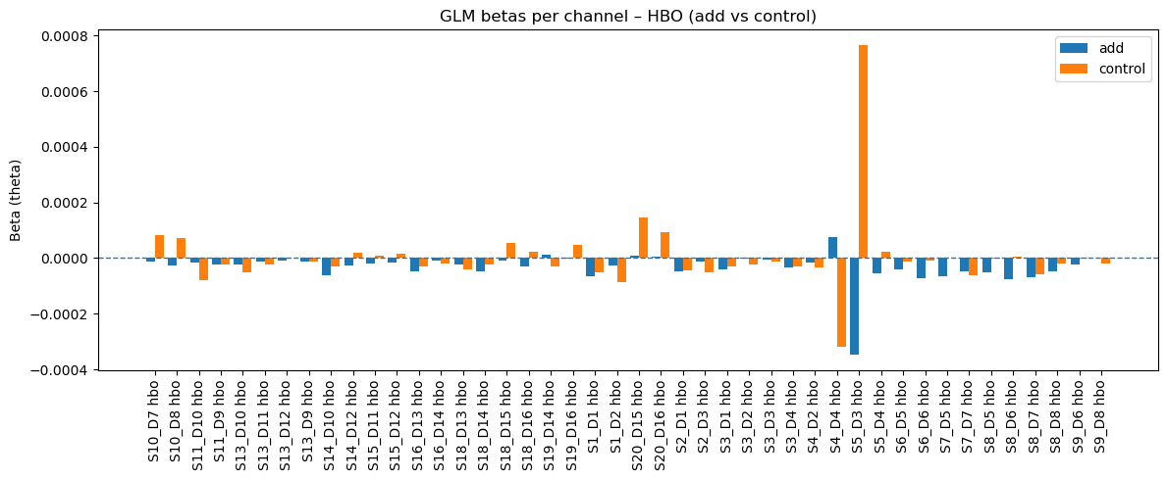
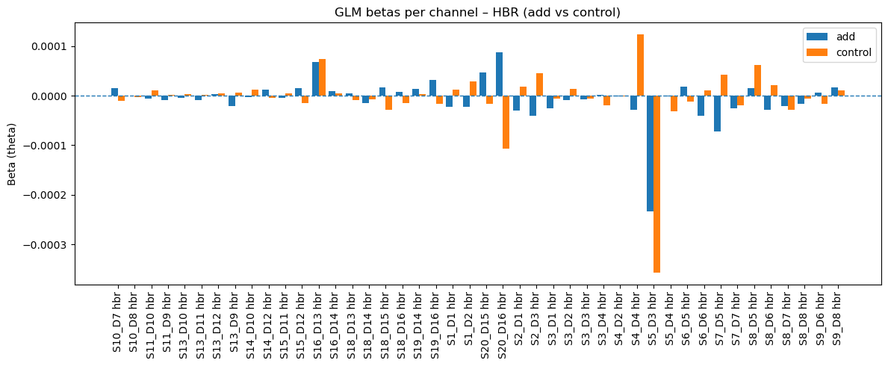
Subject – BNKG; Run 1

Slide 34
